Slide 1

REACTIVE SYSTEMS
AN INTRO TO SIMPLE SYSTEMS THAT SCALE
Neil Dunlop
The JVM Thing, Leeds, May 2017

Slide 2

WHY
BOTHER
< technology – business >
Notes:
We’ve all been building software for a long time.. So why would we bother to change things, after all ’if it ain’t broken, don’t fix it’.
In our industry there are two main drivers for change, technology and business.

Slide 3


Business
AGILITY
isn’t new
Notes:
You could argue that businesses now need to move faster, they need to to be ’commercially agile’ so that they can easily capitalise on new opportunities and be better at responding to change. You could argue that business requirements have not changed over the years.
A classic example of this is NetFlix versus Blockbuster (and the younger audience members asking what ‘Blockbuster’ is… that’s kinda the point). Blockbuster were a retail movie rental business that had total market domination and then Netflix arrived… there is no more Blockbuster…
I don’t think the need to be commercially agile has changed.. Its always been there.. Its just that some businesses are able to do it better than others. Those that can evolve faster, win.
So if the need to be commercially agile isn’t really new, something else must have changed.

Slide 4
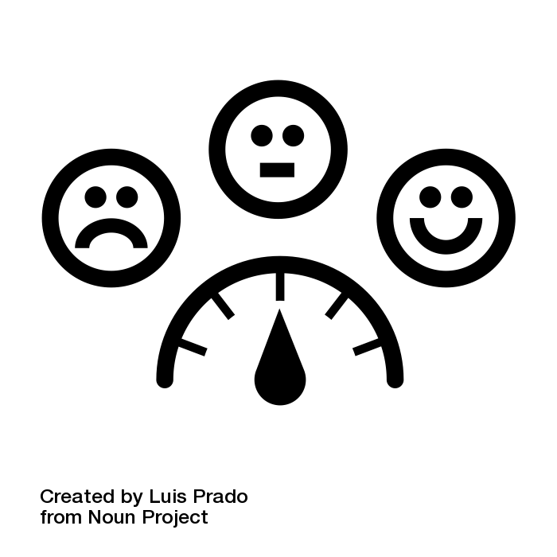
User
EXPECTATIONS
have changed
Notes:
The thing that has changed is our users’ tolerance for failure, their tolerance for service interruption and their tolerance for downtime.
Businesses, and the systems they use have largely been forced because our consumers… and that’s probably the way it should be.
We build these systems to be used and they should work in the way our users expect. Those expectations have been raised and if we don’t meet them, things wont end well for us.

Slide 5

“GOOD”
DEFINE
Notes:
So we build systems to be used and for them to be used, popular, commercially viable they have to be ’good’
So what do our users want our system to be? So, what do we want our system to be?
What are the characteristics that define a ‘good’ system?

Slide 6
REACTIVE MANIFESTO
http://www.reactivemanifesto.org
Notes:
It turns out that quite a few people, in various industries, have been thinking about what defines a ‘good’ system, and they have managed to distil their thinking into a mercifully concise document…
The Reactive Manifesto.
Talks about Principles rather than tools and techniques.
Establishes a shared vocabulary for talking about the attributes we desire from our systems.
Helps people to make conscious design decisions rather than everyone having to discover them independently time and time again.

Slide 7
REACTIVE SYSTEMS
Responsive
Elastic
Resilient
Message Driven
Notes:
There are 4 key elements to reactive systems that are all interlinked.
Having one attribute enables others.
If we are message driven, we can be elastic.
If we are message driven we can be resilient.
If we are message driven we can be responsive.
If we are Elastic then we can be Resilient and Responsive
If we are Resilient then we can be Elastic and Responsive
Ultimately all of these attributes contribute to our systems being responsive.
They survive and function well in the fact of increased load and even the failure of components.
They may degrade, but they wont die.

Slide 8
RESPONSIVE
in detail
Responds in a timely manner if at all possible.
Provides rapid, consistent response times with consistent quality of service.
The system makes it simple to handle errors and encourages further interaction.
Responsiveness allows problems to be detected quickly and dealt with effectively.
Notes:
Whatever I’m doing, the system should respond to what I do.
I should be able to tell that my interactions are having an effect.
When it does respond, it should do it quickly and consistently. Huge differences between response times just make it hard to work.
If things go wrong, it shouldn’t be the end of the world. I should be able to deal with the error and keep working with the system.
If things go wrong in a related system, it shouldn’t have any impact on my system.
If our system is responsive then we can quickly spot when things go wrong, we can deal with them because they don’t kill my interaction and if the system stays responsive to our inputs we have a good chance of fixing things.

Slide 9
RESILIENT
in detail
Stays responsive in the face of failure.
Resilience is achieved through replication, containment, isolation and delegation.
Parts of the system can fail and recover without compromising the system as a whole.
Failures are contained within each component.
Clients of a component is not burdened with handling its failures.
Recovery of a component is delegated to another external component and high availability it achieved through replication where necessary.
Notes:
Ultimately we want the system to stay responsive and available, even when things go wrong.
We can achieve this by having a resilient system.
We get resilience by using:
replication (having more than one instance of a component)
containment (making sure our components can fail and recover without affecting other parts of our system, the fact that a component went away and came back shouldn’t upset other parts of our system)
isolation (making sure errors don’t leak out and bring other components down and that clients don’t have to do anything special to handle a failure in our components).
delegation our components are not responsible for recovering themselves after a failure. We have another component supervising them which will take action to recover them if needed. This makes our components simpler to build.

Slide 10
ELASTIC
in detail
Stays responsive under varying workload.
We increase or decrease the resources dedicated to processing inputs in response to those inputs increasing or decreasing.
No central bottlenecks. Components can be sharded or replicated and inputs can be distributed amongst them.
Systems scale either reactively or proactively by looking at relevant performance metrics.
Elasticity is achieved using commodity hardware and software platforms.
Notes:
Ultimately we want the system to stay responsive, even when things get busy.
An elastic system is one that scale up or down depending on demand.
If we see more traffic hitting the system, we scale up, we create more instances of key components, automatically and we begin to send messages to those components.
When things get quieter, we scale down and go back to fewer instances of our components.
To make sure our system can be elastic, we need to ensure there are no bottlenecks in our system. No golden components that all the messages flow through. If it can’t be replicated and have inputs distributed across it, then its not elastic.
Elastic systems should scale based on performance metrics, they are how we know when to scale. You can do it reactively or you can do it proactively. It depends on how fancy you want to get.
The clincher is that scaling shouldn’t require any fancy software or hardware. With modern platforms, using commodity hardware and software is entirely possible.

Slide 11
MESSAGE DRIVEN
in detail
Communication between components is asynchronous, non-blocking.
Asynchronous messages enforce component boundaries and ensures:
Loose Coupling, Isolation, Location Transparency,
Ability to delegate errors as messages.
Message Driven allows:
Load Management and Elasticity
Flow Control by applying back pressure as needed.
Efficiency - Consumers wait for, but are not inherently coupled to producers.
Notes:
Being message driven given us lots of benefits and is the key enabler for Reactive Systems.
By passing messages asynchronously between our components we ensure that we don’t have to have a direct, long lived connection between our components where one component is holding the connection open until it gets a response from another component.
By passing messages we are encouraged to be clear about what each component does and what its responsible for.
We are encouraged to have clear boundaries between components and clear contracts for their behaviour.
By not having direct comms between components we can move components around (location transparency) and by monitoring the number of messages being passed around we can judge system load, scale up or down as needed and control the flow of messages between components.
By using back pressure one component can signal to another that it getting overwhelmed and tell the producer to slow down. This gives us a lot more efficiency in our systems and stops slow components being knocked over by faster components. Components are related but not coupled. We have lots of flexibility in our systems

Slide 12

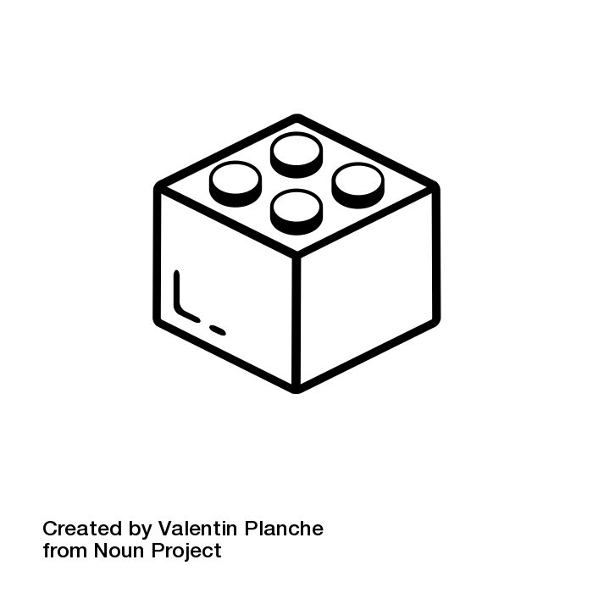
SYSTEMS
How we build
must change
Notes:
As our user expectations have changed, and indeed the number of users our systems get and the way those users interact with our system has changed, we have had to change how we build our systems.
As you are probably painfully aware, the art of system development changes regularly.
New ideas emerge, old ideas die off, old ideas re-appear.
In the past, we had tens of servers, thousands of users and hours of offline maintenance and Gigabytes of storage.
Now we have potentially thousands of servers, hundreds of thousands of users, downtime is not tolerated and Petabytes of data is generated.
Managing these kinds of systems is no trivial matter.
In face of these fairly radical changes, the tools and techniques we use to build system has had to change.

Slide 13
APPROACHES
< one– more- go>
Monolith
Microlith
Microservices
Reactive
Notes:
To be fair, we’ve had a go at this before.
We started with Monoliths. All the logic, all the data, all together in one big lump. If a part fails, then everything dies and you have a bad day.
Then arguably we moved to Microliths, and these look a bit like microservices, but don’t be fooled. While we might have services with clear boundaries that do one thing well, they are usually fairly closely coupled and they usually share a database.. Which is bad. If some of your components die, you might survive. If your database dies, you’re going to have a bad day.
Recently we’ve moved to Microservices and we’ve stopped sharing databases. However, we’ve probably not put a lot of thought into resilience and portability.. And if we have, its probably not as easy as we’d hoped, because we’ve never really though about this a lot.. And we’ve not done much of that kind of work before.
When all your experience is with monoliths and all your tooling makes it easy to build monliths.. Guess what.. You build monoliths.
The way that we design and implement systems is defined by the tools available to us.
Lots of new technologies have emerged that make it a lot easier to build ‘Reactive’ system.
When new tooling emerges, we take a breath and rethink how we implement our systems.
Its hard to say which comes first, the tooling or the desired design… but change in one can often re-energise the other.

Slide 14

Time for a
DEMONSTRATION
Notes:
But, enough of my waffle..
We did promise this would be practical.
Time for some good stuff!

